Slide 1
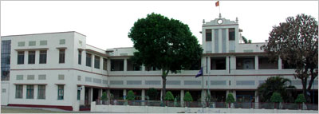
ORGANISED “AIDS DAY” BY SOHAN LAL D.A.V COLLEGE AMBALA CITY

Slide 3
ACTIVITIES :-
SLOGANS
STORY TELLING AND WRITING
POWER POINT PRESENTATION
POSTER MAKING

Slide 4
MEMBERS OF RED RIBBON CLUB (RRC)
Coordinator – DR. Neelam Luthra
Incharge- Ms. Neera
Asst. Incharge – Ms. Somwati
President –Jyoti
Vice president- Narsingh
Finance secretary – Niharika Mishra
Secretary – Mandeep

Slide 5
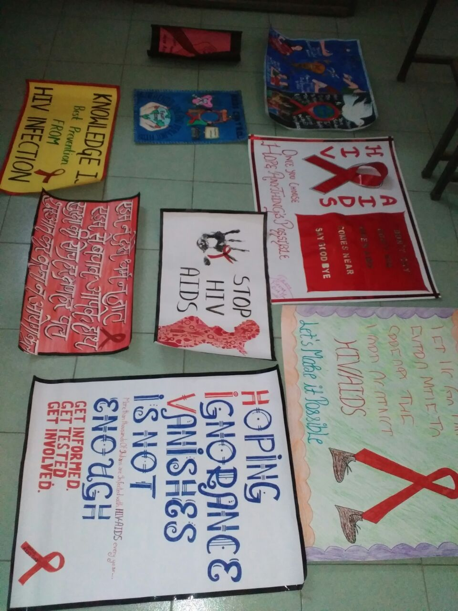
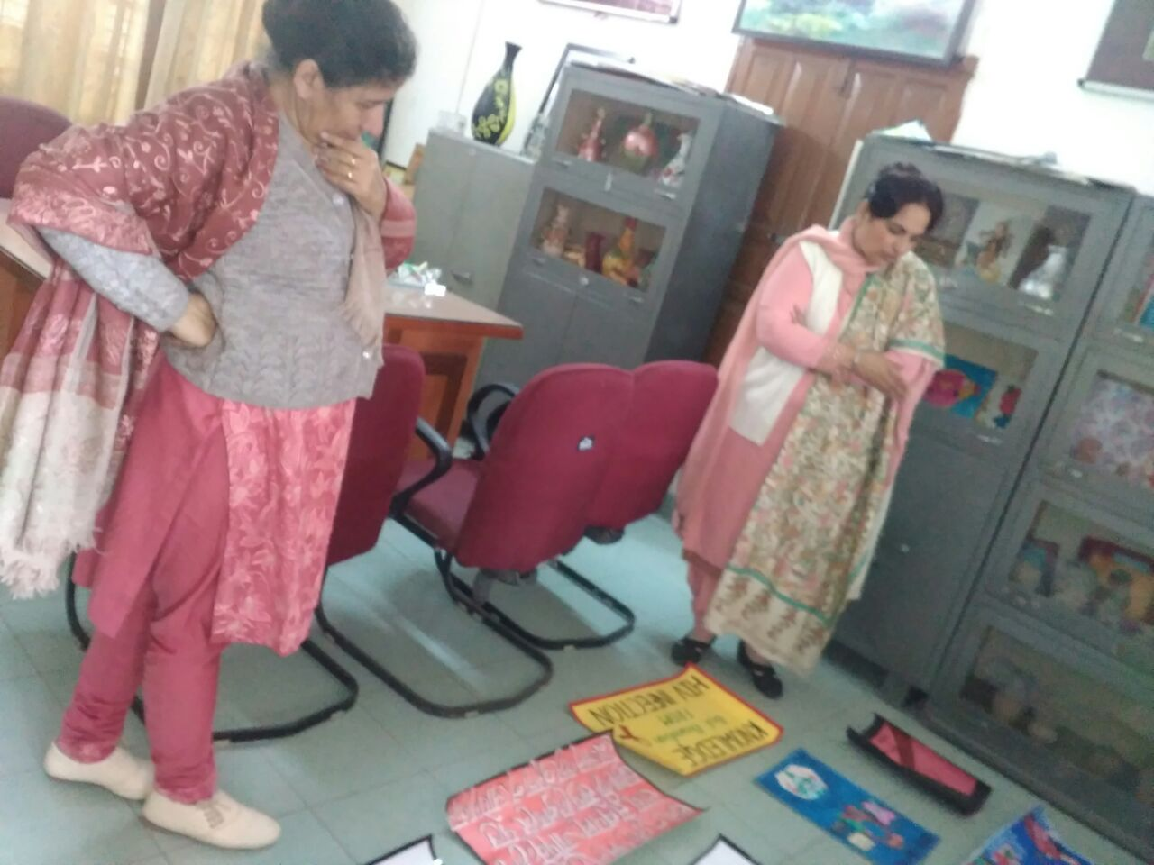
POSTER MAKING
S.NO. | NAME OF STUDENT | ROLL NO. | CLASS
1. | Riya | (17111) | B.Ed.1st
2. | Gayatri | (17067) | B.Ed.1st
3. | Neha Kashyap | (17083) | B.Ed.1st
4. | Seema | (17187) | B.Ed.1st

Slide 6
SLOGAN WRITING
S.NO. | NAME OF STUDENT | ROLL NO. | CLASS
1. | Neha | 17116 | B.Ed. 1st
2. | Harpreet Kaur | 17053 | B.Ed. 1st
3. | Gayatri | 17067 | B.Ed. 1st
4. | Kamalpreet Kaur | 17059 | B.Ed. 1st

Slide 7
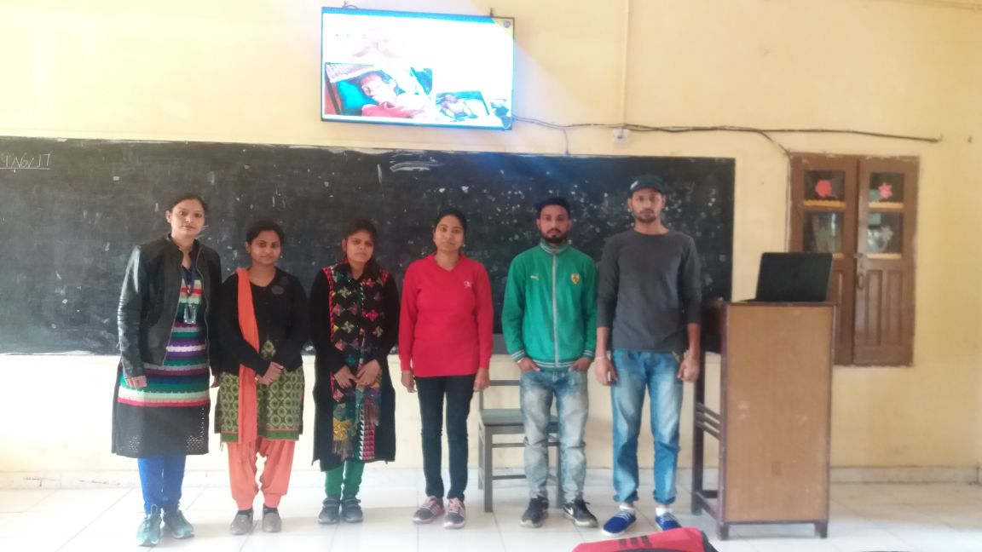
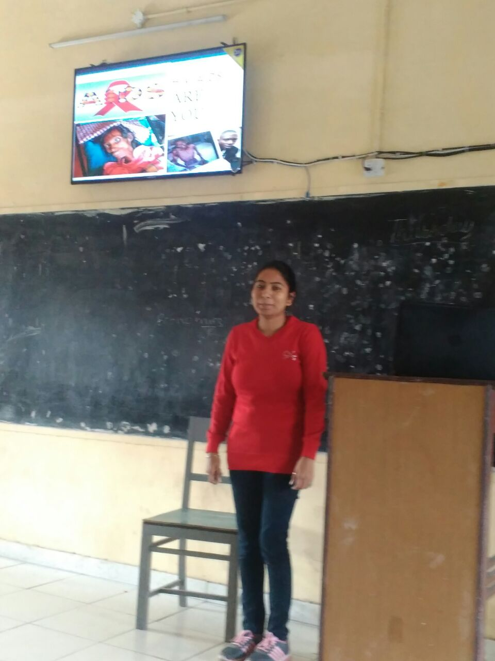
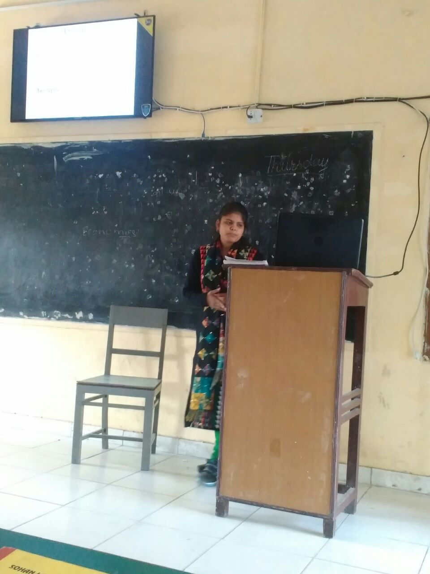
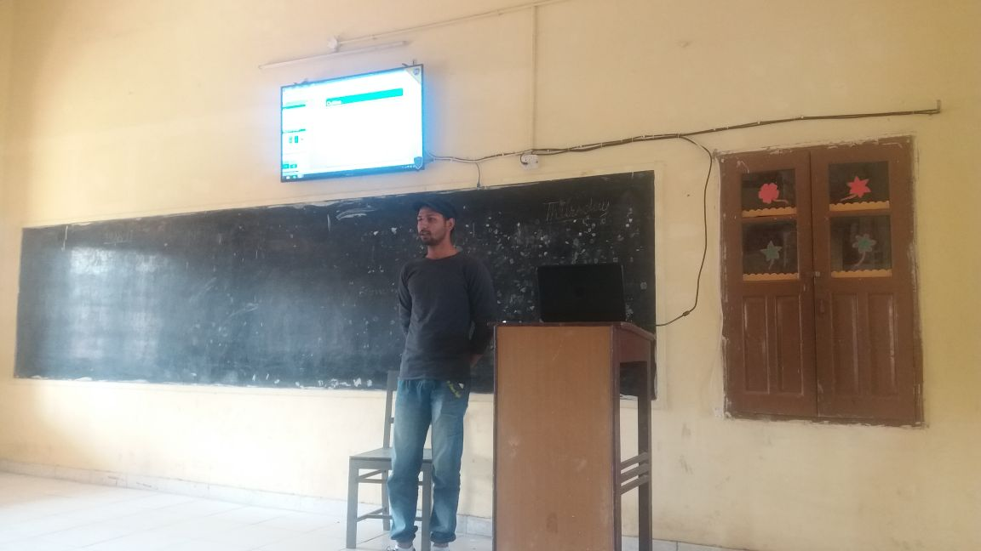
Power point Presentation
S.NO. | NAME OF STUDENT | ROLL NO. | CLASS
1. | Jyoti | 17073 | B.Ed. 1st
2. | Mandeep | 17076 | B.Ed. 1st
3. | Prabha | 17196 | B.Ed. 1st
4. | Mohit | 17223 | B.Ed. 1st
5. | Anju | 17193 | B.Ed. 1st
6. | Shruti | 17178 | B.Ed. 1st

Slide 8
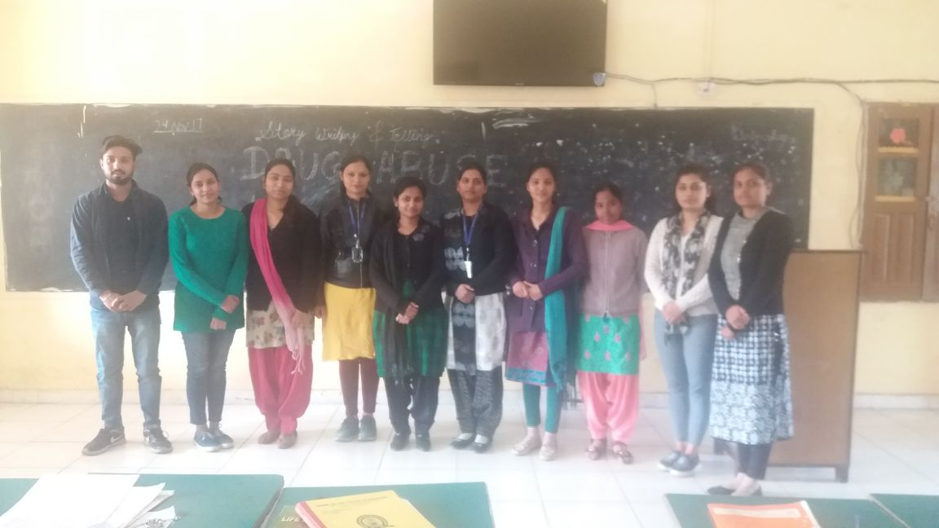
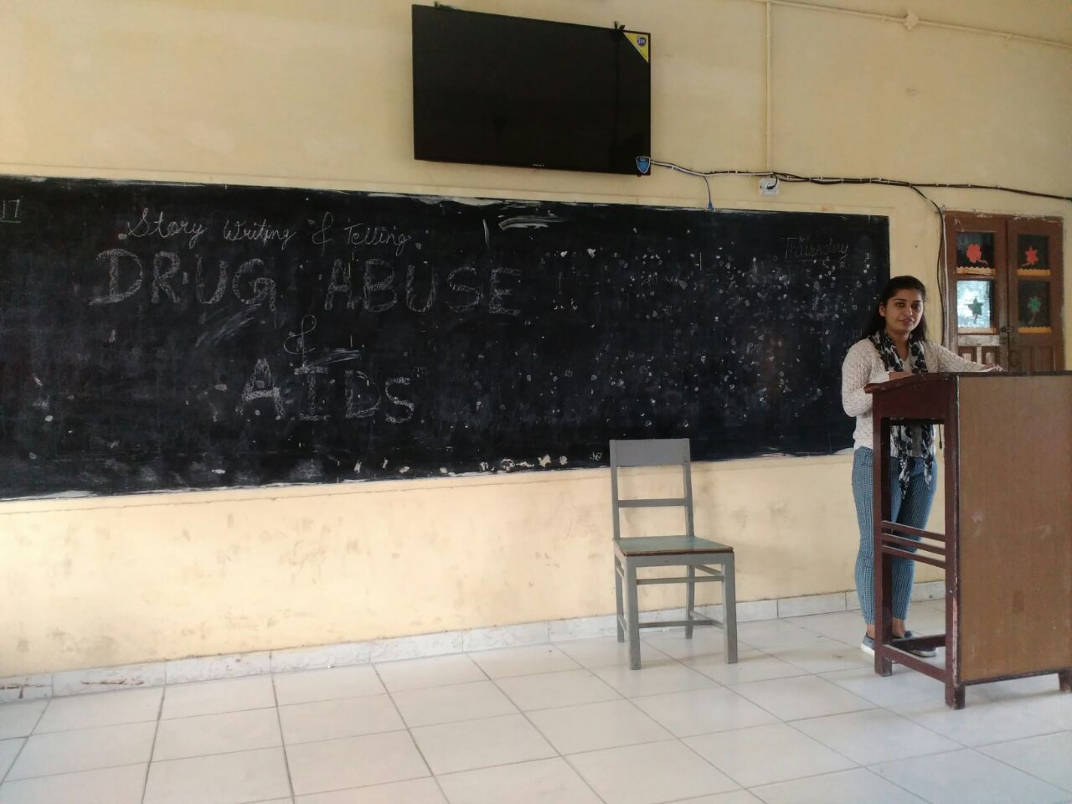
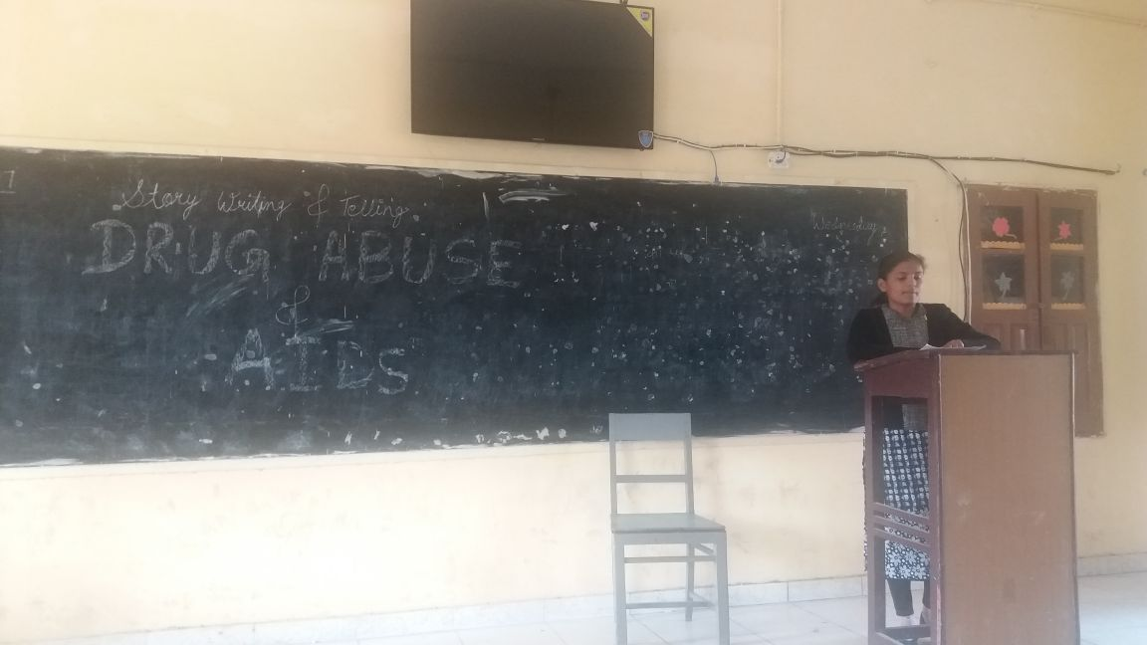
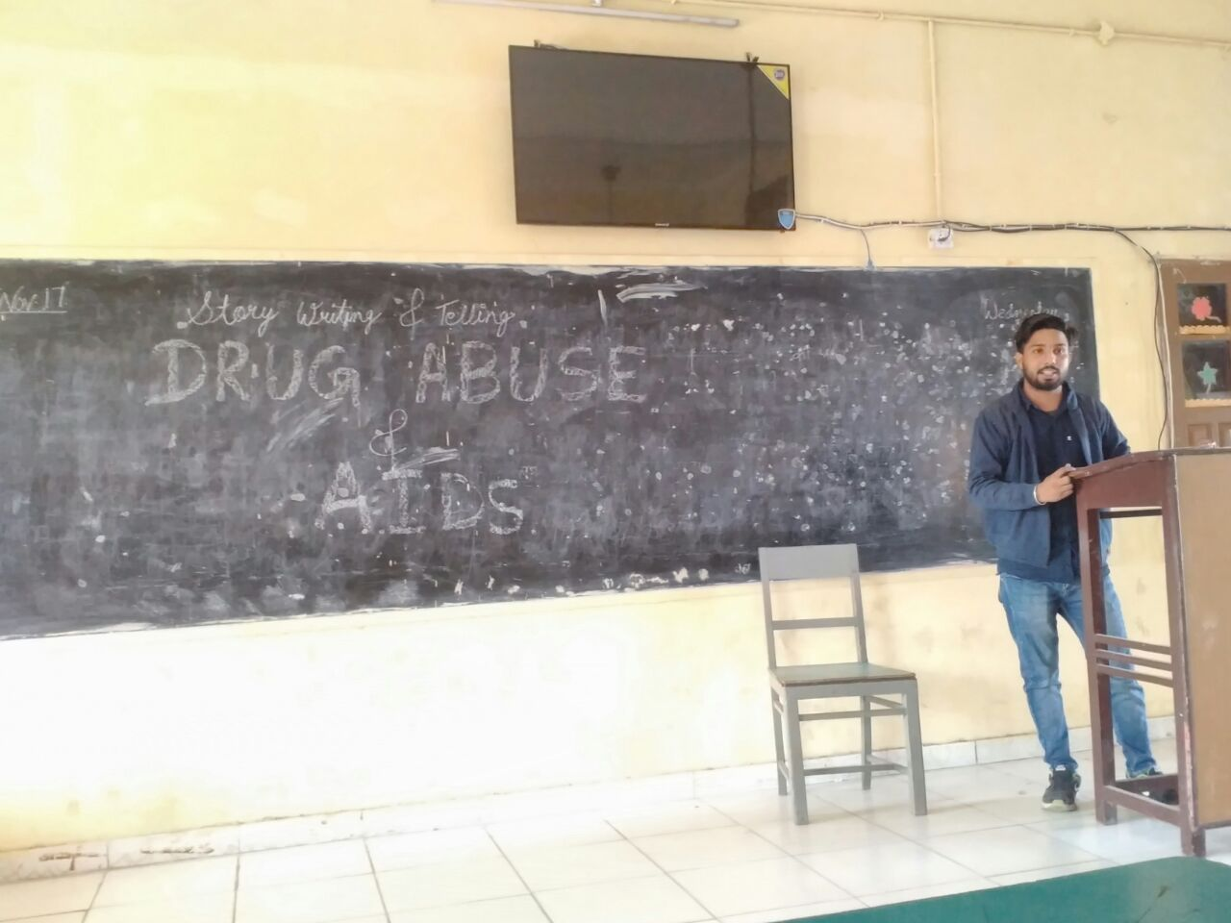
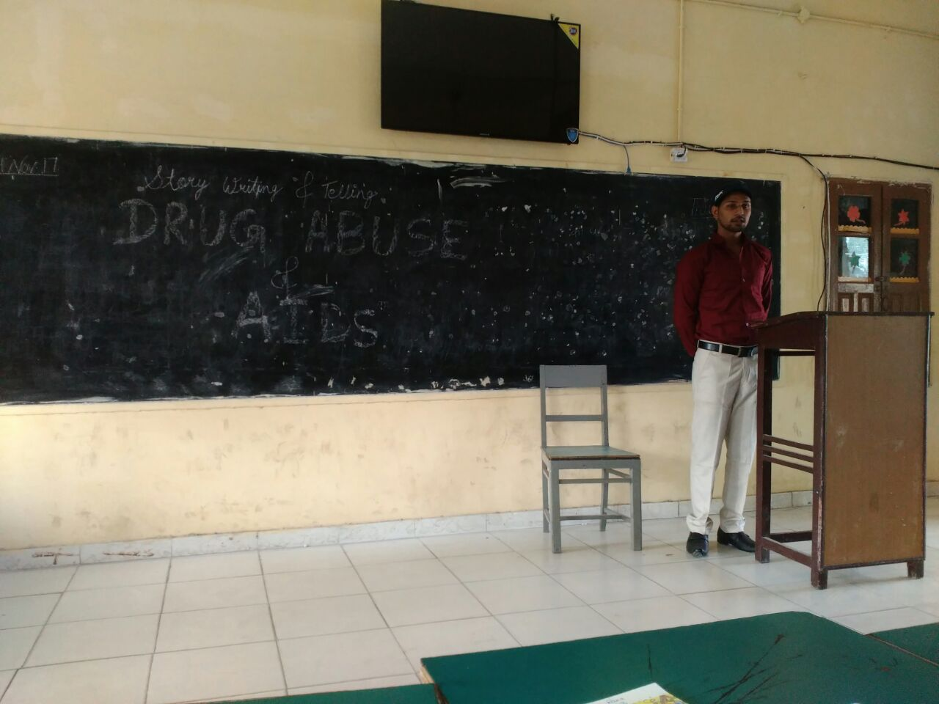
STORY WRITING AND TELLING
S.NO. | NAME OF STUDENT | ROLL NO. | CLASS
1. | Anju | 17193 | B.Ed. 1st
2. | Priya | 17148 | B.Ed. 1st
3. | Mandeep | 17076 | B.Ed. 1st
4. | Jyoti | 17073 | B.Ed. 1st
5. | Kanika | 17068 | B.Ed. 1st
6. | Mohit | 17223 | B.Ed. 1st
7. | Niharika Mishra | 17065 | B.Ed. 1st
8. | Meenakshi | 17197 | B.Ed. 1st

Slide 9
RESULTS
1. POSTER MAKING
1st- Seema (17187)
2nd- Gayatri (17067)
3rd- Neha (17083)
2. SLOGAN WRITING
1st- Kamalpreet Kaur (17059)
2nd- Gayatri (17067)
3rd- Neha (17116)
3. POWER POINT PRESENTATION
1st- Mandeep (17076)
2nd- Jyoti (17073)
3rd- Prabha (17196)
4. STORY WRITING AND TELLING
1st- Jyoti (17073)
2nd- Niharika Mishra (17065)
3rd- Kanika (17068)

Slide 10
THANK YOU

